Slide 1
Consent and the Law
SHARE
Lesson 6

Slide 2
Consent
What does it mean?
What does it mean to ‘give consent?’
Seems pretty straightforward, but is it?
“2 Minutes Will Change the Way You Think About Consent” https://www.youtube.com/watch?v=laMtr-rUEmY

Slide 3
2 minutes Will Change the way you think about consent

Slide 4
Consent, coercion, incapacitated
Consent
Coercion
Incapacitated

Slide 5
“Pitch Perfect 2 Trailer-Ellen Show Version”
Play from (2:10-2:27)

Slide 6
“Tea Consent”

Slide 7
Consent…
Is a clear and ENTHUSIASTIC “Yes”
Any signs of discomfort should be read as a “No”
Only meaningful if it is NOT coerced
A shared responsibility of everyone engaging in or who wants to engage in any kind of sexual interaction.
Must be…
freely given, reversible, enthusiastic, informed and specific with both words and behaviors matching.

Slide 8
Age of consent
The legal age at which an individual is considered mature enough to consent to sex.
NV: 16

Slide 9
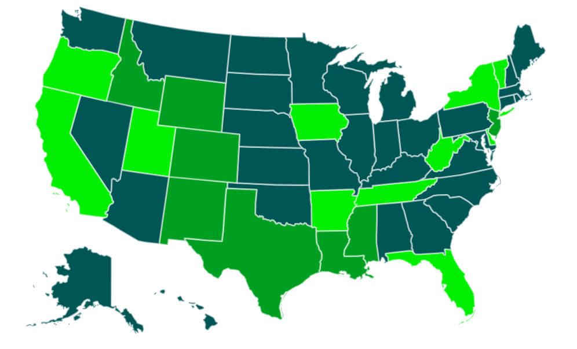
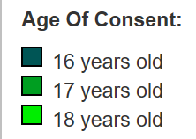
Age of consent Across the US

Slide 10
WAIT! IS THAT SEX LEGAL? Statutory Rape is legally called… Statutory Sexual Seduction
NRS 200.364
“Statutory Sexual Seduction” means ordinary sexual intercourse, anal intercourse, or sexual penetration committed by a person 18 years of age or older with a person who is 14 or 15 years of age and at least 4 years younger than the person who is 18 years or older (defined by law as a perpetrator).

Slide 11
Statutory Rape is legally called… Statutory Sexual Seduction
Are you in a sexual relationship and someone is under the age of 16?
If one person in the consensual relationship is under 16 years old (14 or 15) and the other person is 18 years or older;
Than the older individual is committing a crime of statutory sexual seduction.
The older person can be arrested and sent to prison

Slide 12
Consent is never a defense
If the minor is under the age of 16 and the adult is 18 or older, the sex is a crime, even when both people have consented. The minor is not legally old enough to give permission/consent for any sexual act!
A parent CANNOT give permission to a minor under the age of 16 to have sex with someone 18 or older.
The law has the overall authority!
This also falls under “mandatory reporting”

Slide 13
Penalties for statutory rape
The adult can be arrested and faced with penalties based on the age of the adult.
If the adult is 21 years or older:
Category B Felony
1-10 years in prison
$10,000 fine
If the adult is under 21 years old:
1st offense- Gross misdemeanor.
2nd offense- Category D felony.
If the victim is under the age of 14, this can be considered sexual assault! The older individual will face possibility of being charged with a category A felony, and life in prison.

Slide 14
What is sexual Assault
Any unwanted, forced or coerced sexual activity. Such as…
Inappropriate sexual contact or fondling
Acquaintance rape
Date rape
Stranger rape
Child sexual abuse and incest
Sexual assault is not about sex. It is a crime of violence where sex is used as a weapon, motivated by the desire to have power and control over the victim.
Sexual assault violates not only a person’s body buy also their sense of safety and control over their life.

Slide 15
Sexual assault NRS 200.366
A person is guilty of sexual assault if he or she:
Commits sexual penetration upon a child 14 years old or younger or causes a child 14 years old or younger to make a sexual penetration on himself or herself or another, or on a beast.
Especially if the perpetrator is 18 or older.
NOTE: Sexual Assault includes other acts committed as a crime against a person. This definition is relevant to acts involving a child in relation to statutory sexual seduction laws. Hence, if an adult 18 or older or a child 14 or older commits a sexual act with a child 14 years or younger, whether consensual or not, he/she can face sexual assault charges.

Slide 16
How do I report sexual assault?
Reporting is the survivor’s choice
Reporting is encouraged, however a victim’s decision should always be respected and supported.
Crisis Support Services advocates are available 24/7 to help.
Can also contact your local police department
Call the direct line
Visit the station in person
College campus
Contact campus-based law enforcement

Slide 17
If you are assaulted and you are considering filing a police report, please try to follow these guidelines to preserve evidence:
Do not bathe or douche.
Do not change your clothes.
Do not brush your teeth or use mouthwash.
Do not eat or drink anything.
Do not apply any medication.
Do not disturb or clean up the crime scene.
Even if you do these things, you can still get an exam. Please contact Crisis Support Services if you have any questions or doubts.
1-775-221-7600 or text SASS to 839863 for more information.
https://cssnv.org/sexual-assault/

Slide 18
Forensic examination
Forensic examinations for collecting physical evidence can be conducted up to seven (7) days after an assault has occurred.
You can report the crime and have a forensic examination during this time period even if you have cleaned up and/or choose not to report the incident.
Please call Crisis Support Services 24-hour sexual assault hotline at 1-775-221-7600 or text SASS to 839863 for more information.
https://cssnv.org/sexual-assault/

Slide 19
School laws WCSD Administrative Regulation 4430 Sexual harassment and misconduct by staff
In accordance with Nevada state law
NO student, regardless of his/her age, can legally consent to any form of sexual conduct with a staff member.
Any such conduct by a staff member or volunteer shall result in disciplinary action up to and potentially including termination of employment or the volunteer opportunity and a criminal investigation.
Sexual conduct includes, but is not necessarily limited to, sexual advances, requests for sexual favors and other verbal, nonverbal, or physical conduct of a sexual nature or with sexual implications.
Nonverbal conduct may include contact through social media, to include texting.

Slide 20
Sexual harassment
Sexual Harassment is defined as unwelcome sexual advances, requests for sexual favors, and other verbal or physical conduct of a sexual nature when submission to or rejection of this conduct explicitly or implicitly affects an individual's ability to receive an education, unreasonably interferes with an individual's educational performance or creates an intimidating, hostile or offensive educational environment. The term sexual harassment includes sexual violence under Title IX.

Slide 21
Who to call for help
If you have been a victim of non-consensual sexual assault and are seeking services call
SASS – Sexual Assault Support Services
Call (775) 221-7600 & ask to speak with an Advocate
Text:“SASS” to 839863
Safe Embrace: 775-322-3466
Domestic Violence Resource Center: 775-329-4150
Suicide Prevention and Crisis Hotline:1 (800) 273-8255
National Suicide Prevention Lifeline:1 (800) 273-8255
EMERGENCY: CALL 9-1-1

Slide 22
Teen dating abuse statistics
Did you know?
Nearly 1.5 million high school students nationwide experience physical abuse from a dating partner in a single year.
One in three adolescents in the U.S. is a victim of physical, sexual, emotional or verbal abuse from a dating partner, a figure that far exceeds rates of other types of youth violence.
One in 10 high school students has been purposefully hit, slapped or physically hurt by a boyfriend or girlfriend.
Teen Dating Abuse Statistics
https://www.loveisrespect.org/resources/dating-violence-statistics/

Slide 23
Teen dating abuse statistics cont’d
Lesbians and gay men experience equal or higher levels of intimate partner violence (IPV) as compared to heterosexuals.
Bisexual women suffer much higher rates of IPV in comparison to lesbians, gay men and heterosexual women.
Significantly higher rates of dating violence were reported among LGB youth
42.8 percent of LGB youth compared with 29 percent of heterosexual youth surveyed reported being physically abused by dating partners,
The rates of sexual victimization for LGB respondents was 23.2 percent, nearly double that of heterosexual youth, reported sexual coercion.
Transgender youth reported the highest rates of dating violence, with 88.9 percent reporting physical dating violence.
https://www.hrc.org/resources/teen-dating-violence-among-lgbtq-youth

Slide 24
Types of Relationship Abuse
Physical- hurting someone physically in some way
Emotional- making someone feel bad about themselves by taking away their sense of self or self-esteem.
Psychological- using threats or intimidation to frighten someone or make them feel like they’re losing touch with reality.
Sexual- similar to physical abuse, but sexual in nature.
Financial- when the finances or a person’s potential to earn or have money are controlled by one person.
Reproductive Coercion- one partner strips the other of the ability to control their own reproductive system and timeline
Notes:
Reproductive coercion: https://www.loveisrespect.org/content/reproductive-coercion/

Slide 25
What is a healthy relationship?
OPEN, HONEST AND SAFE COMMUNICATION
It is a fundamental part of a healthy relationship.
It’s making sure you both understand each other’s needs and expectations-being on the same page is very important.
That means you have to talk to each other!
Notes:
A good supporting resource: https://www.loveisrespect.org/wp-content/uploads/2016/08/highschool-educators-toolkit.pdf

Slide 26
Is My Relationship Healthy?
Some signs of a healthy relationship include a partner who:
Makes sure you both understand each other’s needs and expectations-being on the same page is very important.
Respects your boundaries.
Respects your chosen gender pronouns or name.
Gives you space to hang out with friends and family without thinking you’re cheating.
Doesn’t take your money or tell you what to buy.
Never threatens to out you to people.
Never tells you you’re not a real man, woman, lesbian, gay man, trans person or whatever you identify as because you don’t have sex the way they want you to.

Slide 27
The makings of a healthy relationship…
Speak Up. In a healthy relationship, if something is bothering you, it’s best to talk about it instead of holding it in.
Respect Each Other. Your partner’s wishes and feelings have value, and so do yours. Let your significant other know you are making an effort to keep their ideas in mind. Mutual respect is essential in maintaining healthy relationships.
Compromise. Disagreements are a natural part of healthy relationships, but it’s important that you find a way to compromise if you disagree on something. Try to solve conflicts in a fair and rational way.
Be Supportive. Offer reassurance and encouragement to each other. Also, let your partner know when you need their support. Healthy relationships are about building each other up, not putting each other down.
Respect Each Other’s Privacy. Just because you’re in a relationship doesn’t mean you have to share everything and constantly be together. Healthy relationships require space.
Loveisrespect.org

Slide 28
If you think your relationship is unhealthy…
It's important to think about your safety now.
Consider these points as you move forward:
Understand that a person can only change if they want to. Focus on your own needs.
Are you taking care of yourself?
Connect with your support systems.
Talk to your friends, family members, teachers and others to make sure you’re getting the emotional support you need.
Think about breaking up.
Remember that you deserve to feel safe and accepted in your relationship.
Notes:
Understand that a person can only change if they want to. You can’t force your partner to alter their behavior if they don’t believe they’re wrong.
Focus on your own needs. Are you taking care of yourself? Your wellness is always important. Watch your stress levels, take time to be with friends, get enough sleep. If you find that your relationship is draining you, consider ending it.
Connect with your support systems. Often, abusers try to isolate their partners. Talk to your friends, family members, teachers and others to make sure you’re getting the emotional support you need. Remember, our advocates are always ready to talk if you need a listening ear.

Slide 29
Who to contact for help…
The Anti-Violence Project– serves people who are LGBTQ Hotline 212-714-1124 Bilingual 24/7
GLBT National Help Center Hotline 1800-246-PRIDE (1-800-246-7743) or Online Chat at http://www.volunteerlogin.org/chat/
National Sexual Assault Hotline – supports LGBTQ people 1-800-656-HOPE (4673) 24/7 or Online Counseling at https://ohl.rainn.org/online/
Awaken- 775-393-9183
Love Is Respect hotline: 1-866-331-99474 (24/7) or Text “loveis” 22522
Step Up! Nevada, Stop Violence! http://www.stepupstopviolence.org/
SASS – Sexual Assault Support Services
Call (775) 221-7600 & ask to speak with an Advocate
Text: “SASS” to 839863
Domestic Violence Resource Center: 775-329-4150
Safe Embrace: 775-322-3466
Crisis Support Services: 1-800-273-8255
Text “care” to 839863
Wingspan– serves people who are LGBTQ Hotline 520-624-0348 or 1-800-553-9387 Bilingual 24/7

Slide 30
Is it abuse if…?
…a couple is arguing and when one partner begins to freak out the other gives them a a light slap to calm them down?
…a person walks their partner to school every morning, meets them for lunch every day, and picks them up at the end of each afternoon?
…every time a same-sex couple argues, one of the partners threatens to “out” the other to their family?

Slide 31
Is it abuse if…? cont’d
…an 18 year-old has sex with a 14 year old?
…a couple starts “play-fighting” and they wrestle around on the floor resulting in bruises on one of their arms?
…one partner wants to have sex. Their partner says they’re not ready, but after talking about it, gives in and has sex anyway, even though they really don’t want to?
…someone expects to be able to check their partners cell phone/texts anytime they wish?

